Slide 1
The Bauhaus
The house built from 1919 to 1933
Prepared by Leila Aouni

Slide 2
The content
The Birth of the Bauhaus
Teaching at the Bauhaus
The Bauhaus in Weimar: The Realization 1919-1925
The Bauhaus in Dessau: The Evolution 1925-1932
The Bauhaus in Berlin: The End 1933
Bauhaus Architecture
The Bauhaus Workshops
Movements within the Bauhaus

Slide 3


The birth of the bauhaus
After the First World War, Walter Gropius, who had trained in the architectural practice of Peter Behrens and had actively participated in the Deutscher Werkbund movement, sought to develop his innovative ideas in art and architecture by founding the Bauhaus (Building House) in Weimar, Germany, in 1919. This institute of arts and crafts, by extension, taught architecture, photography, costume design, and dance.
The Bauhaus program attracted the support of several artists such as Johannes Itten, Vassily Kandinsky, Paul Klee, Moholy-Nagy, Herbert Bayer, and Joseh Albers. The Bauhaus was relocated to Dessau in 1925, then to Berlin in 1932, where it was finally closed in 1933 by the Nazis, and many artists and teachers fled to the United States of America.

Slide 4
Teaching at the bauhaus
The curriculum is twofold: a four-year training program taught by an artist and a practical program taught by a craftsman. Craftsmen and artists co-direct the workshops.
The curriculum is presented in three parts:
-The first part: A six-month basic course from which around one hundred students are selected.
-The second part is a three-year program, which consists of workshop work. The first three years include the analysis of materials, the use of machinery, teamwork, as well as the more theoretical study of forms, drawing, and color.
-The last part is devoted to the construction and design of a project. The final cycle concerns construction: the student works on construction sites and in various workshops with the master: painting, sculpture, furniture, glass, metal, weaving, pottery, theater, mural painting, architecture, typography, and bookbinding.

Slide 5
The bauhaus in weimar : the realization 1919-1925
Among its principles, the school maintained that art and architecture must adapt to both the needs and the influence of the modern industrial world, and that the quality of a creation depended on the harmony between aesthetics and technology. This is why the Bauhaus offered not only classes in sculpture, painting, and architecture, but also courses in decorative arts, typography, arts applied to industry and commerce, as well as courses devoted to formal symbolism.
Among the Bauhaus professors, Johannes Itten stood out from his colleagues. Indeed, during its first six years, the Bauhaus was marked by the personality of Itten, who was considered a kind of guru who organized a draconian lifestyle; it was he who selected the students entering the Bauhaus.

Slide 6
the bauhaus in dessau : the evolution 1925-1932
The teaching provided at the Bauhaus, in addition to being original, was international. Professors such as Johannes Itten (Swiss), Paul Klee (Austrian), and Wassily Kandinsky (Russian) were of different nationalities, allowing for a more international vision of art.
Among the Bauhaus professors, we find László Moholy-Nagy, who, in 1923, had grasped the precepts of the members of the Glass Chain: light, diffuse artistic structure. He was one of the most important teachers of the Bauhaus. Paul Klee's painting reflects the Bauhaus's evolution towards Constructivism. The Hungarian László Moholy-Nagy, a painter, sculptor, interior designer, filmmaker, photographer, but above all an art theorist, was an excellent teacher. At the crossroads of Suprematism, Dada and Constructivism, Moholy-Nagy's thought is complex and prolific and is close to the thinking of the other Bauhaus professors.

Slide 7
The bauhaus in berlin : the end 1933
The Bauhaus, relocated to Berlin and under the leadership of Mies van der Rohe, no longer had the strength it had in Dessau. From then on, things moved very quickly. The rise of Nazism in Germany since the beginning of the century clashed with the political beliefs of the Bauhaus members, and the extreme right's desire to channel thought made it impossible to provide the kind of education that existed at the Bauhaus in its early days.
By welcoming the main leaders of Dessau, the United States inherited the legacy of the Bauhaus: Gropius was appointed to Hawthorne University and Mies van der Rohe to the Illinois Institute of Technology. Moholy-Nagy, in 1937, created the New Bauhaus in Chicago, which was taken over after his death by Serge Chemayeff under the name of the Institute of Design. Josef Albers taught at Black Mountain College and later at Yale University.

Slide 8
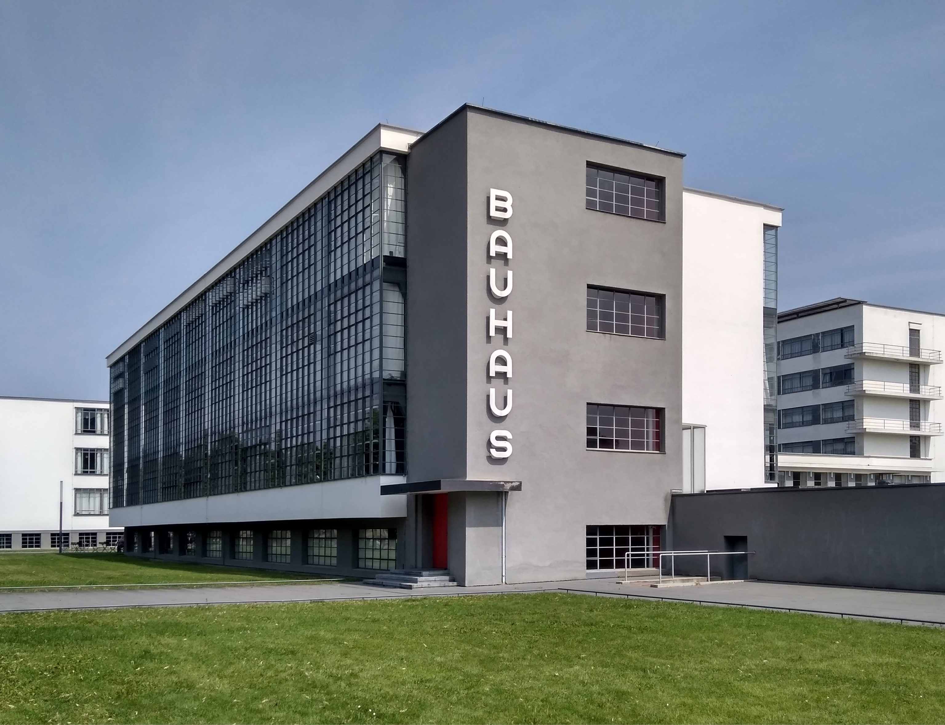

Bauhaus architecture
General Characteristics
Simplicity and functionality: priority given to use over ornamentation.
Straight lines and clean geometry: clear volumes, cubic and rectangular shapes.
Absence of ornamentation: rejection of superfluous decoration.
Openness and transparency: large bay windows for natural light.
Modern materials: reinforced concrete, steel, glass.
Modularity: flexible and adaptable spaces.
Harmony between architecture, furniture, and everyday objects.

Slide 9
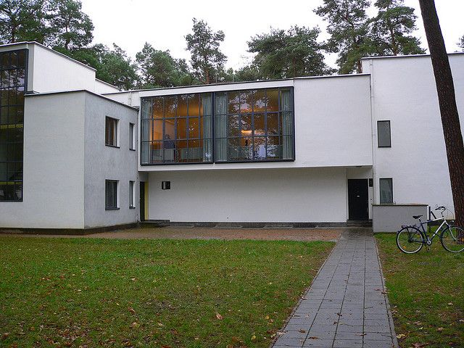
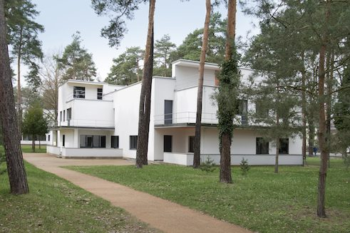
The Bauhaus School in Dessau (1925–1926, Walter Gropius)
Symbol of the movement.
Composition of distinct, interconnected volumes.
Facade of glass curtain walls (immense surfaces of glass).
L-shaped and wing-shaped floor plan to articulate the various functions (workshops, classrooms, theater, dormitories).
The Masters' Houses in Dessau (Meisterhäuser, 1926)
Residences for Bauhaus professors.
White cubes with large bay windows.
Example of a modern, functional, and understated home.

Slide 10
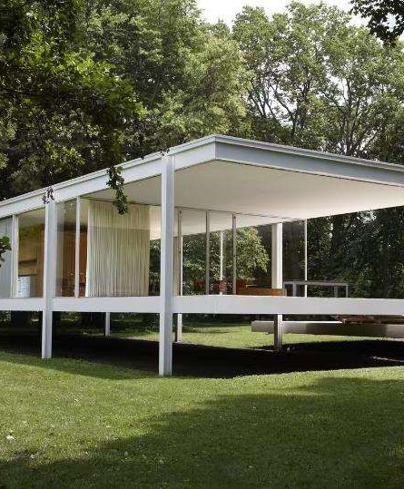
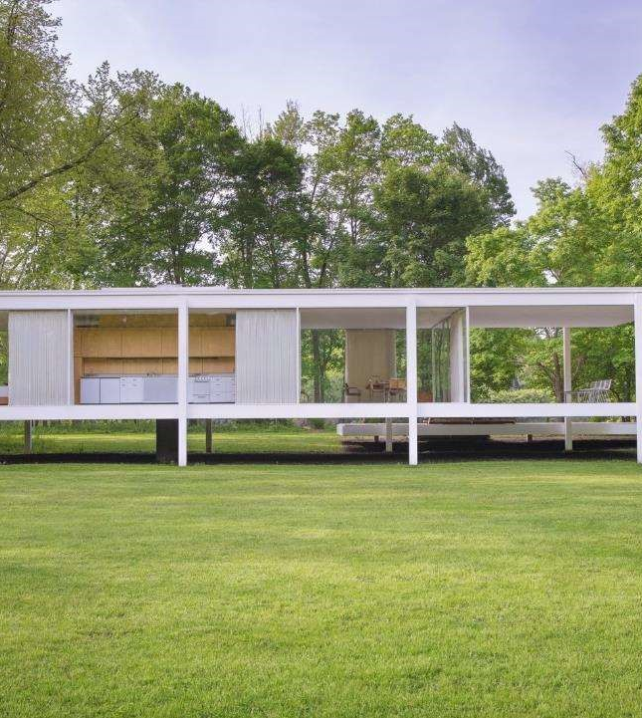
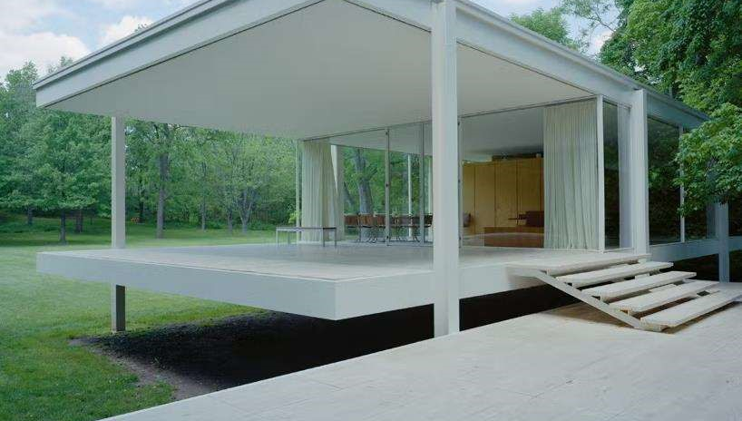
Farnsworth House, Plano, Illinois 1889, Ludwig
Mies van der Rohe
It is a historical house designed and constructed by Ludwig Mies van der Rohe between 1945 and 1951 for wealthy client named Dr. Edith Farnsworth.
The house was constructed as a oneroom weekend retreat in a rural setting in Plano, Illinois.

Slide 11
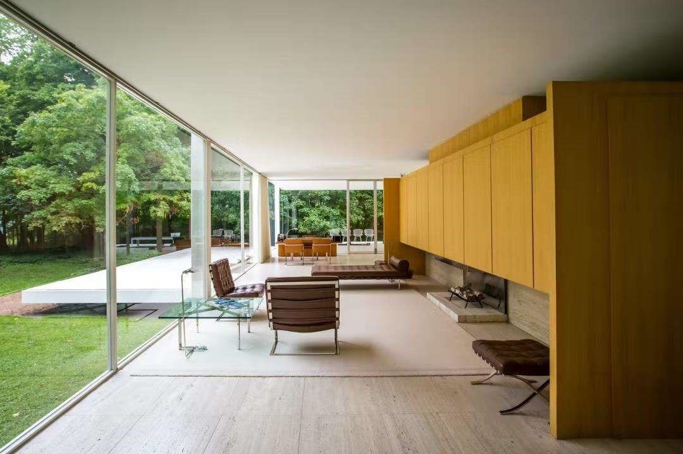
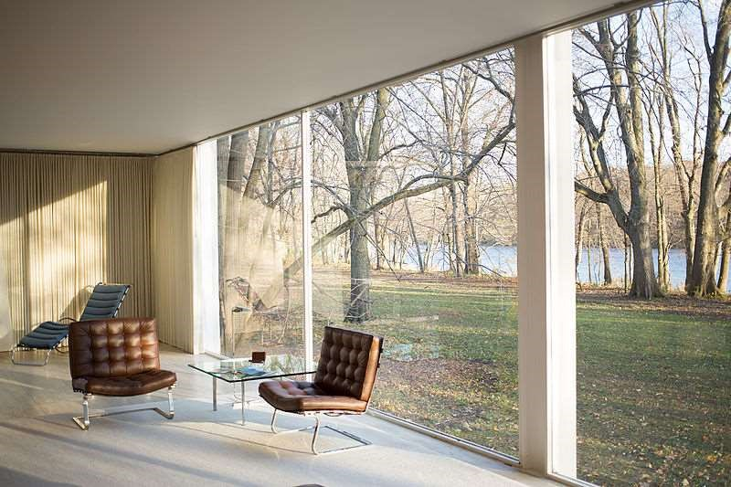
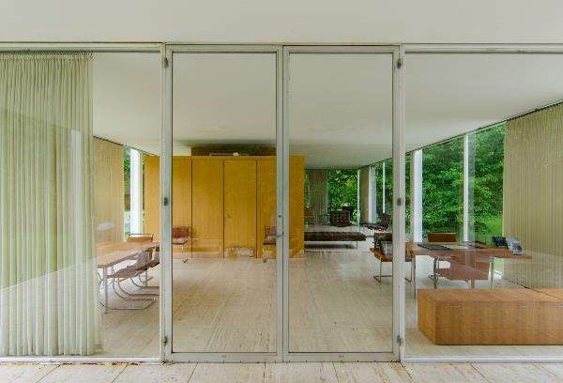
By using a meticulous method called plug welding, seams were erased, resulting in what appears to be an effortless dialogue between positive and negative space.
Materials: Farnsworth House was very much built with nature and terrain taken into consideration.
The principal materials used in this house are glass and steel.
The walls are formed using clear plate glass (glass sheet) and steel pillars are used to create the supporting frame of the building.

Slide 12
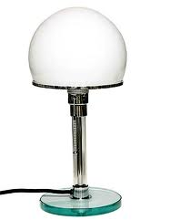
the Bauhaus workshops
The metal workshop, which promotes the use of new materials such as glass and plexiglass, is becoming a product creation studio for industry.
Example: The Bauhaus lamp

Slide 13
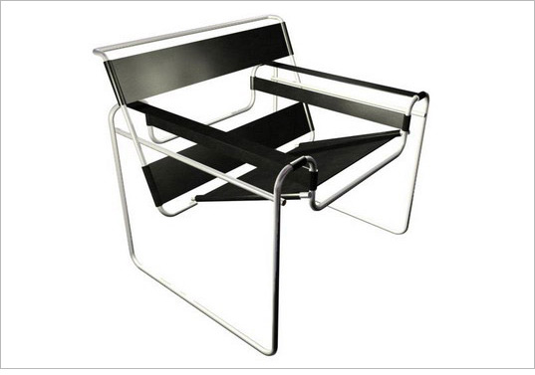
The Carpentry and Furniture Workshop: The workshop moved toward standardization, and its creations were analyzed based on the object. In this workshop, the use of steel to create seating was radically new.
Example: Marcel Breuer's Wassily chair.
Ultimately, the workshop shifted its focus to creating simple, inexpensive, and easy-to-manufacture products, using new materials such as plywood. The furniture became dis-assemblable, re-assemblable, and multifunctional.

Slide 14
The Glass and Mural Workshop: Activities ranged from painting wooden toys to painting buildings and creating murals. The Bauhaus's main commercial success was the creation of wallpaper, which became an industrial product in 1929.
The textile workshop: Different techniques are used such as weaving, crochet, knotting, embroidery, sewing and the creations are in the spirit of abstract art. Production tends to become more industrial and new materials are used such as artificial silk and cellophane.

Slide 15
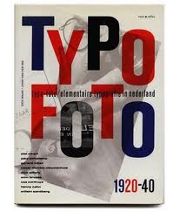
-The Typography Workshop: In 1923, Moholy-Nagy invented a new typeface specific to the Bauhaus school: a blend of symbols and colored elements combined with text and photographs, hence its name "Typofoto."
Another designer, Herbert Bayer, was in charge of the workshop and invented the "Universal" typeface, a rather geometric but sans-serif typeface. He also created another typeface bearing his own name in 1930, "Bayer Type."
Joseph Albers and Johannes Itten also contributed to the development of the Bauhaus typography workshop.

Slide 16

Movements within the Bauhaus
Russian Constructivism
This movement, at the heart of Bauhaus teaching, appeared in Europe around 1920, thanks to Lissitzky Rallia, a Russian painter, architect, decorator and typographer, who was one of the pioneers of constructivism, on the occasion of the first exhibition of Russian abstract art organized by the latter in 1922 in Berlin.
Lissitzky - Poster - 1920 - With a red corner let's push the whites down

Slide 17

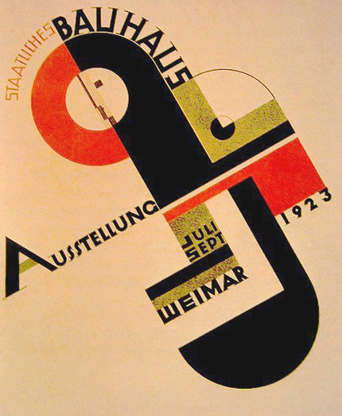
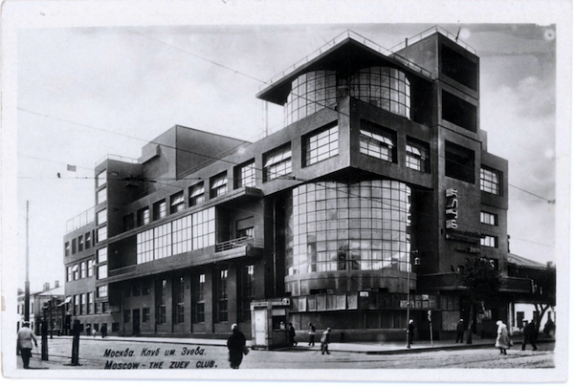
Constructivism came to refer to the style that encompassed all the trends in geometric abstract art in the 1920s and 1930s, which is now referred to by the generic term "constructive art."
The Bauhaus also allowed its former students to teach, as did Josef Albers from 1923 to 1933, who explored the relationships between colors in their geometric abstractions. His classes were particularly grounded in functionalism in modern design.
Rodtchenko - Plakat - 1924
Bauhaus poster 1923

Slide 18
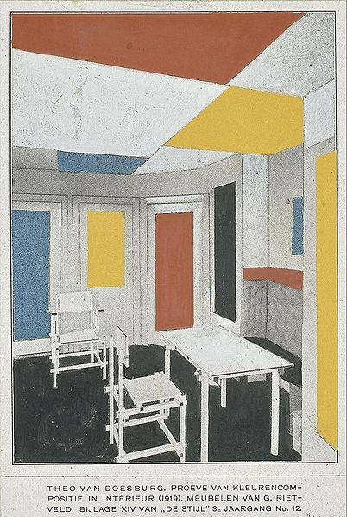
The Dutch de Stijl movement
As early as 1917, a group of Dutch painters, architects, designers, and philosophers formed a collective called De Stijl.
Moving away from the natural forms of architecture and design, the De Stijl group attempted to create a visual language capable of expressing a new industrial aesthetic by using a reduced palette and limiting itself to straight lines.
Theo van Doesburg and Gerrit Rietveld,
Interior of Bart De Ligt's house, 1919

Slide 19
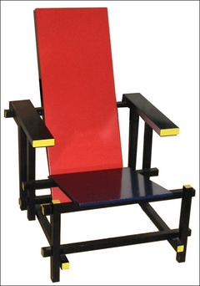
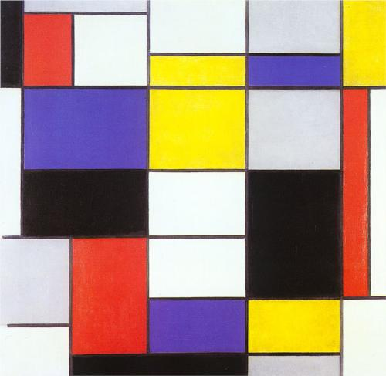
Gerrit Rietveld's Red and Blue Chair
The creators of Le Stijl synthesized their aesthetic and social position with the desire for a new balance between the individual and the universal, as well as the struggle for the detachment of art from the constraints of the cult of individualism.
Piet Mondrian, abstract painting,1923

